Slide 1
CS 4530: Fundamentals of Software Engineering Exam Review
Jonathan Bell, Adeel Bhutta, Mitch Wand
Khoury College of Computer Sciences
WARNING: Please note that students are responsible for all content covered in class so far. These slides are a quick review of some (but not all) of those topics. Feel free to use them as a starting point for your study/exam preparation.
© 2022 Released under the CC BY-SA license

Slide 2
Software Engineering encompasses the entire software development life cycle
Write/Refine Requirements
Create Tests
Code
Debug or Redesign until Tests Pass
Deploy/Collect Feedback
Design

Slide 3
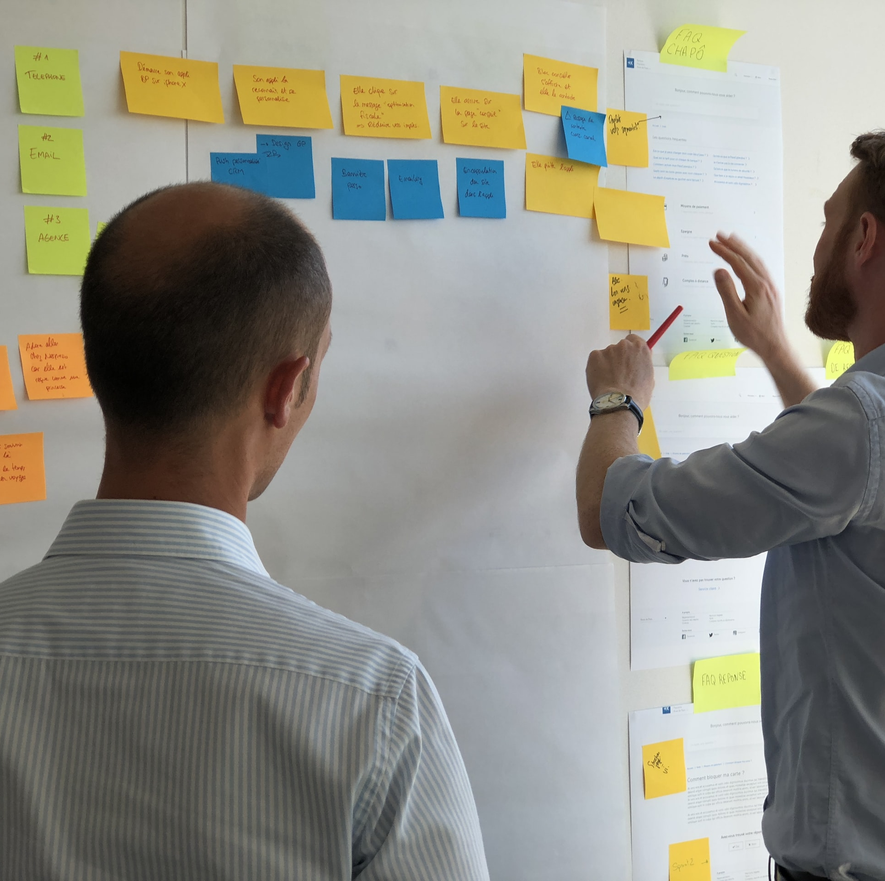
Always need to document the requirements
Documentation helps our whole team make sure they are building the right thing
Documentation can help specify implicit requirements
Documentation can also serve as an artifact to iterate on with a client
Notes:
Whatever combination of methods we choose to solict our requirements, we probably need to document them somehow. Having documented requirements can certainly help make sure that the whole team is on board with what is being made, and to try to minimize having things “lost in translation” – you have something to look back on and say “did I make the thing I said I would make”
It’s very important for our requirements documentation to include non-functional requirements, too, which might otherwise be implicit (unspoken)
This documentation can also serve as a point of reference for us to iterate with a customer, refining the requirements, and ensuring that all stakeholders agree on their completeness/correctness.
There are a lot of options for how to do this…

Slide 4
Documentation should also capture non-functional requirements
Qualities that reflect the execution of the system
Accessibility
Availability
Capacity
Efficiency
Performance
Privacy
Response Time
Security
Supportability
Usability
Example: “A 4-core server with 16 GB RAM should be able to service at least 200 simultaneous clients with less than 300ms latency”
Notes:
Non-functional requirements capture the quality goals of a system.
Here is a partial list of some quality goals, or non-functional requirements that you might need to consider on a project. Note that this is only a partial list, but we included some examples to demonstrate how precise you can be.
For example, one high-level goal is to say “I want performance”. But what does performance mean? You probably mean to say that you expect that the system has some particular capacity (in terms of simultaneous users), who can simultaneously have their requests satisfied within some response time. That’s still not the whole picture though, because you didn’t specify the efficiency of your system: what hardware resources does it use to achieve that performance?

Slide 5
Documentation should also capture non-functional requirements (2)
Qualities that reflect the evolution of the system
Testability
Maintainability
Extensibility
Scalability
Example: “A 3rd party component built conforming to the API defined in the Canvas LMS specification can create, modify, and delete assignments on behalf of an authenticated user”
Notes:
Non-functional requirements might also impact the static existence of the system, or its evolution.
For example, if a customer intends for your software to be particularly long-lasting, and to be able to be extended – this needs to be said. Similarly, if there are specific testing requirements that your customer needs to comply with, there may be testability requirements, that define the effort needed to test the behaviors of that system.

Slide 6
The TDD Cycle
Analyze
Design
Code
Satisfaction Conditions
Testable Behaviors
Executable Tests
Executing Code
Notes:
This depiction of the TDD cycle may be a little different from what you’ve seen before.
To see what all this means, we’ll work through a small example. Along the way, we’ll learn a little Typescript and a little Jest, just enough to do the example.
We start with the user’s satisfaction conditions. We refine those to come up with testable behaviors– concrete, testable things that our system should do. Along the way, we may discover some design decisions that we need to make.
Our next step is to turn these testable behaviors into executable tests. To do this, we will need to design some of our program– at the very least, we will have to decide on the names of the things we will test.
Finally, we write some code that will pass our tests.
Or not so finally– we do this one test (or a few tests) at a time. Once we get our code to pass one test, we go back and get the next test to work. If there are no more tests, we go back to the next unsatisfied testable behavior. And if we have no more testable behaviors, we go back and start on the next satisfaction condition.

Slide 7
Example: a Transcript database User Story
User story: tells what the user wants to do, and why.
Example:
As a College Administrator, I want a database to keep track of students, the courses they have taken, and the grades they received in those courses.

Slide 8

User Stories document requirements from a user’s point of view
Specifying what should happen, for whom, and why
As a <role> I can <capability>, so that <receive benefit>
Conditions of Satisfaction:
Given <interaction with software, state of environment>, I expect <behavior and side effects>
Notes:
User stories are another approach for documenting requirements, which are structured to put the user first. A user story is a short simple description of ONE feature that can fit on a 3x5” card, written in the user’s language.
Why do we focus on the value? Because ultimately our goal with building software is presumably to deliver value – do something that helps some user accomplish some goal. That “something of value” is really what the requirement is. The customer probably doesn’t care to define every possible output for their system for every possible input – instead they just want to tell you what they want to have happen, in language that is as close to their own as possible.
Not called “customer” stories, they are “user stories”. You might develop software for a self-driving car, and your customer is Tesla. But your users is Tesla’s customer. User stories force both you and your customer to focus on your user, who is presumably the one who wants to extract value from your software
“Role” lets us distinguish between the different ways that our software might be used: Canvas is used by both instructors and students. However, there are even more roles, which have different capabilities: TAs can also view grades, but they can’t add new Tas. “Course observers” can see course content, but not grades, and are not enrolled in the class. There are quite a few different roles in Canvas, and maybe you can see how it would help to organize features in that way.
User stories describe the capabilities that your software should provide. They do NOT directly describe the full behaviors of those capabilities. Under what circumstances should this capability be provided? What should happen if it can’t be provided? How do we expect users to actually interact with our system, and what results should we see?
Conditions of satisfaction are a vital part of user stories; they typically are longer than can fit on an index card – hence if you are not using some project management tracking software, but are writing stories on cards, you’ll typically put the conditions of satisfaction somewhere else, like in your project management tool
Conditions of satisfaction are, effectively, test cases – or templates for test cases. These kinds of tests are sometimes called “acceptance tests” because they constitute the end-user accepting that your software does what they want. Cool!
What makes a good user story?

Slide 9
Writing User Stories: INVEST
Independent
Negotiable
Valuable (has value to client)
Estimatable
Small
Testable
As a <role> I can <capability>, so that <receive benefit>
Notes:
Popular mnemonic for describing what makes a good user story
Independent – Stories should not be coupled between each other, except where obviously necessary. Want to make it so that a user can examine a story on its own
Negotiable – Best stories are result of a negotiation between a client and a developer – how do we come to some mutual agreement about what we are going to build, and why? Goal is to develop what the customer needs
Valuable – Each story should have some benefit that the client can recognize. Value might include value to your business, not just value to the user.
Estimatable – As we will see in a bit, being able to estimate how long it will take to implement a user story is key to determining a reasonable scope for your project
Small – A rule of thumb is to average 3-4 days of work per-story. Again, we’ll see this fit in with estimation.
Testable – There must be some way to judge completion: for the person implementing the software, and for the end-user.
https://agileforall.com/new-to-agile-invest-in-good-user-stories/
… Let’s see an example and work through some of the tricky bits

Slide 10
Satisfaction Conditions
Satisfaction Conditions list the capabilities the user expects, in the user’s terms.
Example:
My database should allow me to do the following:
Add a new student to the database
Add a new student with the same name as an existing student.
Retrieve the transcript for a student
Delete a student from the database
Add a new grade for an existing student
Find out the grade that a student got in a course that they took

Slide 11
Our next step is to turn these satisfaction conditions into testable behaviors
To do this, we will have to design our program at least enough to give names to the things we want to test.
For our example, we need to design the external interface for our database.
We document this in a file we will call IDataBase.ts

Slide 12
We start with the interface
import {StudentID, Student, Course, CourseGrade, Transcript} from './Types'
export interface IDataBase {
addStudent (studentName: string): StudentID
getTranscript (id: StudentID): Transcript
deleteStudent (id: StudentID): void // hmm, what to do about errors??
addGrade (id: Student, course: Course, courseGrade: CourseGrade) : void
getGrade (id: Student, course: Course) : CourseGrade
nameToIDs (studentName: string) : StudentID[]
}
The types are all abstract
In the process of writing this down, we’ve discovered some more design decisions:
How to identify a student to the DB user
What to do about exceptional conditions in deleteStudent and elsewhere
We needed a new method to get from a student name to their ID.
Notes:
A Typescript interface is similar to a Java interface. Here is the TS syntax. We import some types from ./Types (which we will write pretty soon now), and export the interface.

Slide 13
Now we can write down some testable behaviors.
These could serve as titles for our tests
Testable Behaviors:
addStudent should add a student to the database
addStudent should return an ID that is distinct from any ID in the database
addStudent should permit adding a student with the same name as an existing student
Given the ID of a student, getTranscript should return the transcript for that student
Given an ID that is not the ID of any student, getTranscript should <hmmm…. What *should* it do??????>

Slide 14
Five general-purpose design principles
Five General Principles
1. Use Good Names
2. Make Your Data Mean Something
3. One Method/One Job
4. Don't Repeat Yourself
5. Don't Hardcode Things That Are Likely To Change
Notes:
Here are five general-purpose principles that apply to just about all programming tasks. We’ve phrased this in terms of programming practices: things that you can do to make your code better.
I suggest that you make a sticky note with this list and keep it on your laptop screen or somewhere in your workspace so that you will be constantly reminded of it.

Slide 15
Examples of Design at the Structural Scale
Object-Oriented
Pipeline
Pipeline + Database
Layered
Notes:
<Cover if time>
This lesson has been about design at the code level. Here’s some brief introduction to the other two scales, starting with top level, also sometimes called Architecture level.
<read slide>
Although we will cover just a few, there are many more: like Plug-in architecture (firefox, vsc), event-driven architectures (android, mobileOS), P2P (Zelle, bitTorrent), Microservices (Firefox). Many modern large scale systems are now heterogeneous (i.e., combination of many)

Slide 16
The Interaction Scale: Examples
The Pull pattern
The Push pattern (aka the Observer* Pattern or Listener Pattern)
The Factory* Pattern
The Singleton Pattern* (aka the Lying Factory)
*These are “official Design Patterns” that you will see in Design Patterns Books
Notes:
In this lesson, we will study 4 different interaction-scale designs: the pull pattern (which is so simple it hardly counts as a pattern), the push (or Observer or Listener) Pattern, the Factory Pattern, and the Singleton Pattern.
All but the first of these are “Official Design Patterns” that you will see in Design Patterns Books, and they have standard names. That’s important, because if you need to tell your teammate about what you’ve done in a certain part of your program, you can say “for such-and-such, we use the Observer Pattern”, and then your teammate will know what you mean, because they know what the phrase “Observer Pattern” means. This is what we mean when we talk about using a shared vocabulary.
We may use many different Interaction-scale designs for different portions of our program.

Slide 17
Run-to-completion semantics
A computation runs continuously until it is either suspended or completed.
This means that only one of your computations is running at any time (in addition to whatever asynchronous IO is running)
A computation is suspended when it hits an ‘await’. The runtime system (node.js, for us) chooses what to do next. (In addition to whatever asynchronous IO it may be doing).

Slide 18
One concurrent computation can wait for the result of another one.
async function makeOneGetRequest(requestNumber:number) {
const response = await axios.get('https://rest-example.covey.town');
console.log(`For request ${requestNumber}, server replied: `, response.data);
}
Axios.get is also an async function, so it returns a promise (let’s call it p)
The await suspends the current computation until the promise p returns.
While the current computation is suspended, other computations (including p) can run.

Slide 19
Example:
async function makeThreeSimpleRequests() {
makeOneGetRequest(1);
makeOneGetRequest(2);
makeOneGetRequest(3);
console.log("Three requests made")
}
makeThreeSimpleRequests()
$ npx ts-node example2.ts
Three requests made
For request 2, server replied: This is GET number 280 on the current server
For request 3, server replied: This is GET number 281 on the current server
For request 1, server replied: This is GET number 282 on the current server
Notes:
Note:
When one request starts, this code proceeds to the next one.
The starting process ran to completion: the Console.log executed before the requests.
Transmission is out-of-order: Request 2 evidently reached the server before Request 1.

Slide 20
Awaiting a promise prevents your method from continuing
async function makeThreeSerialRequests(): Promise<void> {
await makeOneGetRequest(1);
await makeOneGetRequest(2);
await makeOneGetRequest(3);
console.log('Heard back from all of the requests')
}
makeThreeSerialRequests();
For request 1, server replied: This is GET number 37 on the current server
For request 2, server replied: This is GET number 38 on the current server
For request 3, server replied: This is GET number 39 on the current server
Heard back from all of the requests
Elapsed time: 364.0822000205517 milliseconds
Notes:
Here, the caller waits for each request to finish before starting the next one.

Slide 21
Promise.all starts several promises concurrently
async function makeThreeConcurrentRequests(): Promise<void> {
await Promise.all([
makeOneGetRequest(1),
makeOneGetRequest(2),
makeOneGetRequest(3)
])
console.log('Heard back from all of the requests')
}
Promise.all takes a list of promises and runs them all concurrently.
It finishes when all the promises have finished.

Slide 22
Promise.all allows for concurrency
async function makeThreeConcurrentRequests(): Promise<void> {
await Promise.all([
makeOneGetRequest(1),
makeOneGetRequest(2),
makeOneGetRequest(3)
])
console.log('Heard back from all of the requests')
}
makeThreeConcurrentRequests();
For request 2, server replied: This is GET number 58 on the current server
For request 1, server replied: This is GET number 59 on the current server
For request 3, server replied: This is GET number 60 on the current server
Heard back from all of the requests
Elapsed time: 203.7674999833107 milliseconds
Notes:
Here all three requests are sent out concurrently.

Slide 23
Visualizing Promise.all (1)
Sequential version: ~400msec
Concurrent version: ~126msec
async function makeThreeSerialRequests(): Promise<void> {
await makeOneGetRequest(1);
await makeOneGetRequest(2);
await makeOneGetRequest(3);
console.log('Heard back from all of the requests')
}
async function makeThreeConcurrentRequests(): Promise<void> {
await Promise.all([
makeOneGetRequest(1),
makeOneGetRequest(2),
makeOneGetRequest(3)
])
console.log('Heard back from all of the requests')
}
“Don’t make another request until you got the last response back”
“Make all of the requests at the same time, then wait for all of the responses”
Notes:
We should leverage concurrency whenever possible. Again, in this example, it seems like it’s probably OK to make all of the requests at once, and then wait for the responses.
Multiple “awaits” on left means (read slide)
Promise.all on right means (read slide)

Slide 24
Visualizing Promise.all (2)
Sequential version: ~400msec
Concurrent version: ~126msec
async function makeThreeSerialRequests(): Promise<void> {
await makeOneGetRequest(1);
await makeOneGetRequest(2);
await makeOneGetRequest(3);
console.log('Heard back from all of the requests')
}
async function makeThreeConcurrentRequests(): Promise<void> {
await Promise.all([
makeOneGetRequest(1),
makeOneGetRequest(2),
makeOneGetRequest(3)
])
console.log('Heard back from all of the requests')
}
Time
Time
makeOneGetRequest #1
makeOneGetRequest #2
makeOneGetRequest #3
makeOneGetRequest #1
s
wait for response
r
s
wait for response
r
s
wait for response
r
s
wait for response
r
makeOneGetRequest #2
s
send
s
wait for response
r
receive
makeOneGetRequest #3
r
s
wait for response
r
Notes:
Concurrency lets us mask latency.
Well-written asynchronous code leverages concurrency when possible.
If you have a bunch of things that can be done at the same time, say, making 3 requests to servers, and you don’t care the order in which those requests are made, then do not write code that enforces any ordering. The example on the right will produce output that might have a different order than the one on the left, but if we are OK with that, we can mask how slow that I/O is by doing things concurrently.
(Click through builds to see the sequence of operations. The * stands in for console.log, boxes are not to-scale. Notice how on the concurrent one the results got printed as 3,2,1.
In this simple example the performance difference is a small absolute number (130msec), but another way of saying it is that the code on the left is 3x slower!

Slide 25
Agile Manifesto
We are uncovering better ways of developing software by doing it and helping others do it. Through this work we have come to value:
That is, while there is value in the items on the right, we value the items on the left more.
Individuals and interactions
Working software
Customer collaboration
Responding to change
over processes and tools
over comprehensive documentation
over contract negotiation
over following a plan
https://agilemanifesto.org
Notes:
The agile manifesto outlines the key principles that underpin agile processes. There are a variety of interpretations of this idea, “software craftsmanship” and “extreme programming” are some.
These values are a direct response to the waterfall processes.
Individuals and interactions – talk about things, localize knowledge vs these big modeling-based approaches. Typically embrace pair programming
Working software – write code that works and is readable, come up with techniques to make it be more likely to be correct.
Respond to change – manage uncertainty by designing and implementing what you need today, don’t make detailed plans in the future
Please note that agile is often talked about as a set of principles and processes that must be obeyed to the letter of the law. We do not claim what is the One True Way™, and many companies will offer certifications in agile this or agile that. Our focus for the next two lessons will be on understanding how agile principles manage risk and improve quality in software development.
If you would like to share this context, it is interesting to point out that the “Agile manifesto” was written and co-signed by 17 white men at a ski resort in Utah. This talk has a nice discussion of this - https://www.youtube.com/watch?v=YL-6RCTywbc

Slide 26
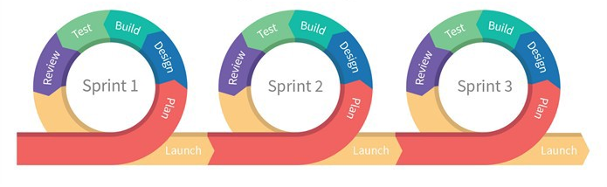
Agile Processes are Iterative
Agile Process Model
Iterative Waterfall Model
Initial Concept
Requirements
and Iteration
Planning
Next Iteration
Design and
Implement
Acceptance
Testing
and Delivery
Operations
Key Idea: Small Continuous Releases
Notes:
Let’s start with a process graphic.
The “process graphic” for agile looks very similar to the iterative waterfall model. Both contain the same phases, pretty much. Both contain a loop. What is different?
Agile has 3d rendering, colors, and round edges.
At its core, agile processes feature the same kinds of activities as the “traditional” processes before it. However, simply saying that you have multiple iterations of your project doesn’t really do anything to reduce the cost of changing requirements or late-detected defects.
The key idea in agile is being able to continuously evaluate the correctness and quality of software. This feeds directly into another key practice of agile processes: small, continuous releases.

Slide 27
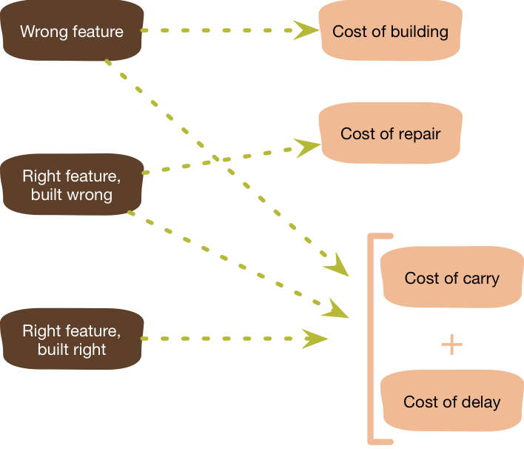
Agile Principles for Effective Planning: YAGNI
YAGNI – “You Aren’t Going To Need It”
Do not pre-maturely plan or implement features
Why? Uncertainty in what we actually need
Focus on prioritization, independent of estimation
Graphic: Martin Fowler
Notes:
With this lesson from meteorology in mind, let’s start to talk about the principles of agile planning. Recall that one of the goals of agile processes is to embrace uncertainty. The first principle is articulated by Martin Fowler in the acronym “YAGNI” (pronounced yag-knee).
If we go into a software project with the first principle “embrace change”, then we need to be willing to tolerate changes to our requirements that come from our users. We also need to embrace changes to our process and plans that come from our evolving understanding of what it is that we need to build, and how it should be built.
The YAGNI philosophy argues that pre-maturely planning and implementing features will almost inevitably result in wasted effort and a delayed schedule. Why? Because with a lot of software projects, both we and our customers may not know exactly what it is that is needed until we get closer to needing it. Consider the hurricane map: 5 days out, can we know what degree of preparations should be in Ohio or Indiana, which seem like they might be outside of the track of the storm, but could also be totally outside of the track of the storm?
One risk is that we end up building the totally wrong feature, in which case we wasted time planning and building that feature, plus the cost to continue to maintain and carry this feature that we now implemented, and the cost to delay other more important features. Building the feature in the wrong way also adds the cost to do it right, and even in the best case (where we built the feature correctly), we have still delayed other more important things from getting built

Slide 28
Tracking and Prioritizing Tasks: Product Backlog
PlowTracker Product Backlog
List of user stories for the product
All entries should add value
No low level tasks
Items are prioritized
A living document
Item | Priority | Value
The driver’s interface should display unplowed streets | High | Required for MVP – drivers must know where to go
The driver’s interface should track which streets have been plowed | High | Required for MVP – informs rest of system what has been plowed
The city official’s internal interface should show estimated arrival times for plows | Low | City officials field thousands of complaint calls, expected to increase citizen satisfaction
The driver’s interface should show an optimized plowing route | Low | Plowing will become more efficient, cuts fuel and labor costs
Members of the public should be able to see real-time plow status | High | Government transparency groups want this; it might reduce phone complaints
Notes:
Then, our product backlog might look more like this: we can easily determine that the internal interface should be lowered in terms of priority, and the public interface should be elevated. The backlog is a living document: an artifact that we can use to spark conversations with our teammates, and with our customers. The backlog tracks the current state of our overall development goals, their priorities, and their values.
Notice how YAGNI helped save us from inadvertently making a technical decision that it was easiest to implement the city official’s internal view at the same time as the driver’s interface. We might have started to implement that (since we would need it later, anyway, right?), but then found that we didn’t need it yet, instead needed the public interface more urgently, and are not going to be able to deliver it as quickly because we still haven’t finished implementing the driver’s interface because we wasted time on the city official’s interface.

Slide 29
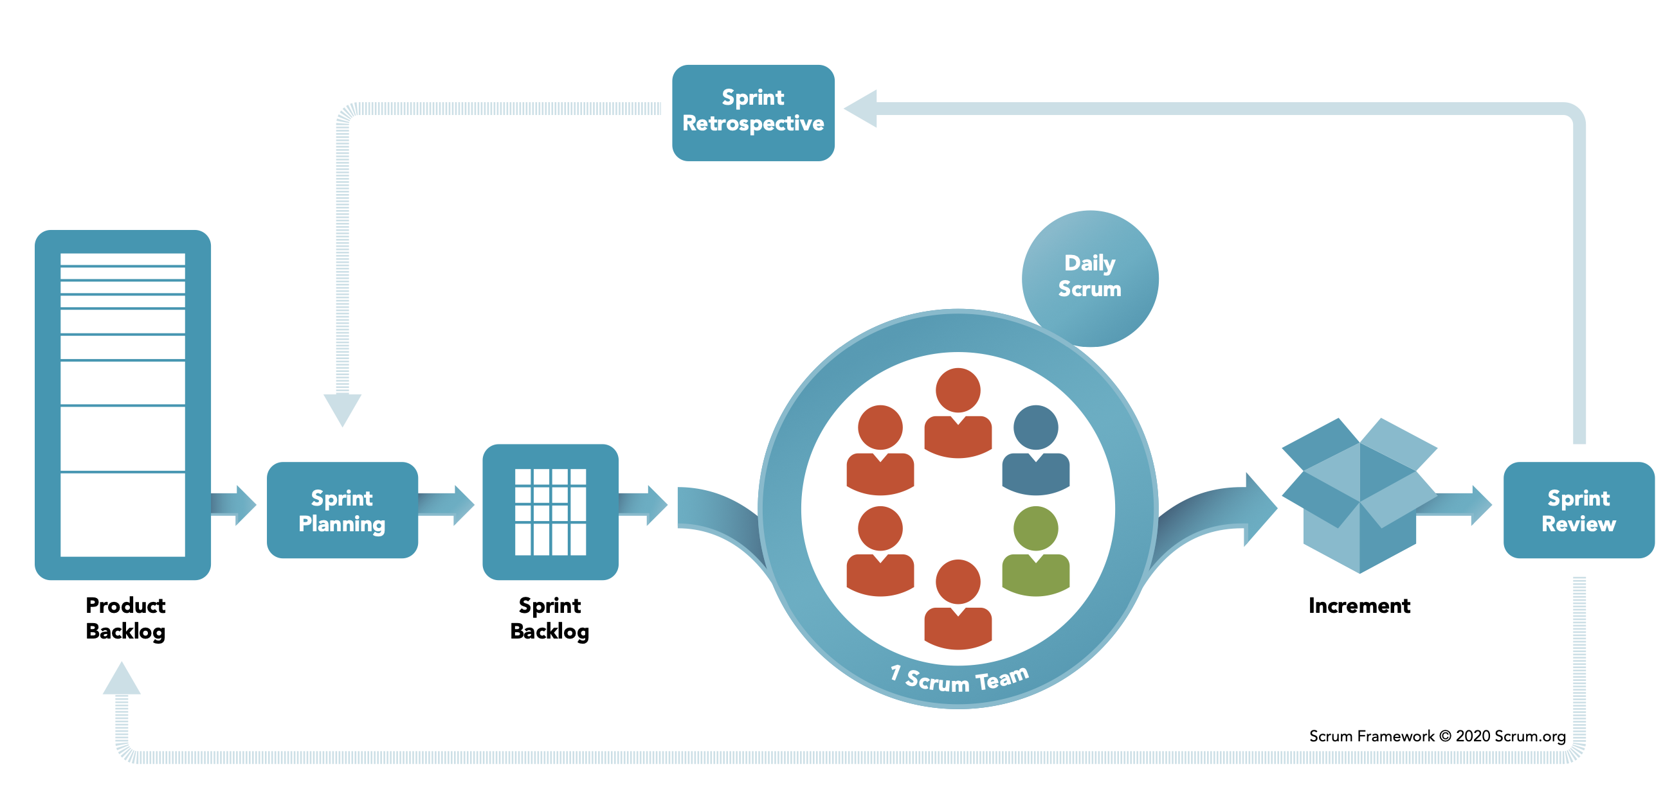
Scrum: Daily progress towards product goals
Notes:
So, how do we go from this product backlog to some delivered software? Scrum is the most common approach to organizing agile projects. There are a few key vocabulary terms that you need to understand in order to talk about scrum, which hopefully won’t be too hard to understand. We’ve already seen one of the artifacts that are used in the scrum process: the product backlog.
Using this product backlog as our starting point, scrum organizes our development activities into sprints, which are time-boxed (fixed duration). Most commonly, sprints are 2 weeks, but it’s also not unusual to see a 30-day sprint. In scrum, we focus most of our planning activities on each of these sprints
The first phase of a sprint is planning: a meeting with the whole team. For a 2-week sprint this meeting is usually capped at 4 hours, and for a 30-day sprint, capped at 8 hours. In the first half of the meeting, the team decides on what can be done in the sprint, setting goals. Then the team decides on how to do that work, creating detailed tasks that will take one day or less.
During the sprint, there are short, “Daily Scrum” meetings – timeboxed to 15 minutes.
At the end, there is a sprint review of what was done, including key stakeholders and users, and a retrospective of what went well or could be improved.
Do not plan the next sprint until the last one is complete.
Implementing an effective scrum process is, however, much harder than reading this slide is – it helps to have a deep understanding of the agile principles to get into the right mindset. In particular, it’s important to reflect on the way that your team can inspect its performance and adapt to change. We’ll discuss each of these key steps, and continue to use the PlowTracker app as a running example.

Slide 30
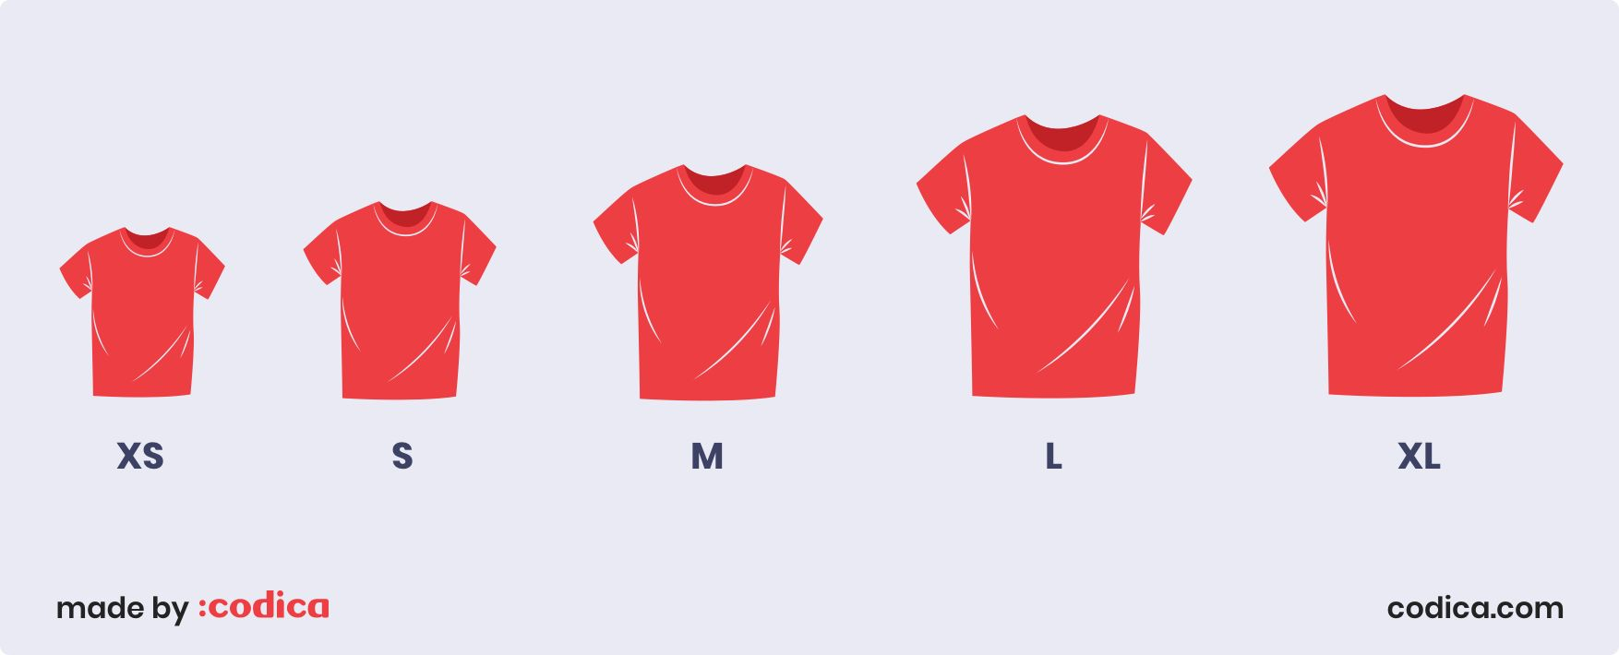
Estimating with T-Shirt Sizes
Notes:
XS are things we really know how to do quite quickly
S are a bit bigger. We’ve done this exact task before, it takes more than a few minutes, but we know it can be done with ease
M – maybe things we have experience with, but not that exact task.
L– challenging task that will need investigation.
XL – huge amount of work and complexity.
What we like about t-shirt sizes is that they are relative: we define how hard something will be based on what we’ve done before. We also like that they do not directly imply time estimates, because the time estimates are likely to be under-estimates anyway.

Slide 31
Sprint Review and Retrospective
Sprint Review:
Provide a working demo
What did we get done?
What value did we deliver?
Sprint Retrospective
What went well?
What could we have done better?
If incidents occurred: conduct a blameless postmortem
Provides an opportunity to reflect on overall project velocity
Notes:
At the end of our sprint, there are two additional meetings, a review and a retrospective.
Remember, sprint duration is fixed: it is possible that not everything planned gets done, and that is OK.
Sprint review – demonstrate the value that was delivered: what tasks did we get done, what stories are complete, what actually works?
Sprint retrospective – how do we improve our process? Key part of agile is continuous process improvement. Look at all sorts of things:
How did our process, and our tools, work for us (or against us)
How did our relationships with other teams develop?
What could make us more productive, or help us enjoy our work more?
Example - Avoid repeated overtime: it is symptomatic of process problems, and you likely need to decide to change your time estimate, your scope, or inevitably you will reduce quality
Everyone’s biggest question with estimation is: “When will the feature (or entire project) be delivered?”
This is a hard question to answer, and Agile offers no silver bullet here. This process provides us with a regular opportunity to reflect on the overall project velocity, however. If we estimate each remaining user story as a t-shirt size, how many large, medium, and smalls are left? We can calculate metrics of how quickly we tend to finish those tasks… But it’s all still just an estimate! :/
One related questions often is: Why are projects late? Here are some reasons:
* an unrealistic deadline established by someone outside the software development group
* changing customer requirements that are not reflected in schedule changes;
* an honest underestimate of the amount of effort and/or the number of resources that will be required to do the job;
* predictable and/or unpredictable risks that were not considered when the project commenced;
* technical difficulties that could not have been foreseen in advance;
* human difficulties that could not have been foreseen in advance;
* miscommunication among project staff that results in delays;
* a failure by project management to recognize that the project is falling behind schedule and a lack of action to correct the problem

Slide 32

Agile Favors “Two-Pizza” Teams
Q: How many people on a team?
A: “No more than you could feed with two pizzas”
Rationale:
Decrease communication burdens
Focus conversations to relevant topics
Notes:
A common way to refer to these “small” teams is to think about it in terms of how big of a meeting you will have when you bring your whole team together, usually no more than 9 people.
Imagine having a Scrum meeting with 6 team members. In your 15 minutes, each team member gets about 2 minutes to share what they did since the last meeting, what they are . You can have a meaningful interaction, where problems are shared and solutions identified.
Now imagine that same meeting, but with a team of 20. In your 15 minutes, each team member gets less than a minute to share the same. How can you effectively have the same meaningful interaction?
Oh, just make the meeting longer, they say. Make it 40 minutes – then everyone still gets 2 minutes! But now, in addition to using up much more of each person’s day, you risk losing focus: are all 20 team members really going to be able to make an effective contribution to help each other on their tasks?
So, two pizza teams

Slide 33
Three Pillars of Social Skills
Pillar 1: Humility: You are not the center of the universe (nor is your code!). You’re neither omniscient nor infallible. You’re open to self-improvement.
Pillar 2: Respect: You genuinely care about others you work with. You treat them kindly and appreciate their abilities and accomplishments.
Pillar 3: Trust: You believe others are competent and will do the right thing, and you’re OK with letting them drive when appropriate.
From “Debugging Teams” by Ben Collins-Sussman and Brian Fitzpatrick
Notes:
If we agree that there are no 10x engineers, and that we need to form effective teams in order to scale up our software engineering processes, then perhaps we can agree on some ground-rules for working productively with our team mates. These three pillars are taken from the book “Debugging Teams” - the authors of this book are long-time software team leads at Google.
Both trace almost every social conflict that they have witnessed in their orgs back to a lack of one of these three traits.
This lens (HRT, pronounced “heart”) is useful for evaluating all kinds of personal conflicts. We work with others, and will be most effective when we can create long-lasting relationships with our colleagues who will be able to help us out later when we need. For example: nobody wants to work with someone who consistently behaves like they are the smartest person in the room. Give and receive constructive criticism.
(some notes on pillars)
Humility – it’s fun to be the most knowledgeable person in the room, and mentoring others can be rewarding. It is easy to get addicted to being the lead on projects – you start out as the person who knows the most about something. But, eventually you will need to change directions and get exposed to new things. Once you reach a local maximum on your team, you stop learning. And then you get bored. Put yourself outside of your comfort zone, and be open to trying new things that you are less confident about. Be willing to show some weakness.
Respect – how do you criticize and give feedback on someone’s work while recognizing their strengths?
Trust – Might feel hard at first if you have been burned many times by team-mates who you delegated something to and who were, simply put, incompetent. Requires a two-way commitment. Trust that you can delegate something to someone else, and that they will have the respect and humility to ask for help if needed.

Slide 34

Responding to Failures
In software, in humans, and in processes.
How do we learn:
What went well?
What went wrong?
Where we got lucky?
How do we prevent it from happening again?
Notes:
One of the most exciting parts of working on a big project with a team is that you have the chance to make something far bigger than you could have on your own.
Unfortunately, a corollary to that is that it’s also possible to have a larger-scale failure than you could have made on your own.
It’s extremely likely that you will, if you have not yet, experienced a problem on your team. Perhaps you had a significant software failure (like a bug being released into production, or someone delaying the development process), a human failure (like interpersonal issues with a teammate) or a process failure (like a testing system that doesn’t actually test what you thought it would)
Putting out fires is a topic for another lecture. The part that is relevant for our team discussion, is the most important thing for the future:
…how to learn from mistakes. How do you learn from mistakes? We usually want to learn what went well (what worked?), what went wrong (obviously the house caught on fire, but why?), where we got lucky (the fire department was already close!), and how we can prevent this from happening again.
The process of reflecting on and learning from these mistakes can be formalized into a “post mortem” review

Slide 35
Blameless Post-Mortems
What actions did you take at the time?
What effects did you observe at the time?
What were the expectations that you had?
What assumptions did you make?
What is your understanding of the timeline of events as they occurred?
Notes:
In order to figure out what went well, what didn’t, and where we were lucky, we need answers to all of these questions. How can we get true answers if there is fear of punishment or retribution? Engineer might misrepresent the actions that they took to make themselves look better, or play dumb about the effects that they saw

Slide 36
useState Tracks Mutable State
const [state, setState] = useState<TypeOfState>(initialValue);
useState returns an array of length 2: the first value is the current state value, second is a setter we can call to update that value. React doesn’t know or care what names you choose here (var, setVar are convention though!)
<TypeOfState> is an optional generic type parameter to declare the type of state
initialValue is the value that state should take before the first call to setState
export function LikeButton(){
const [isLiked, setIsLiked] = useState(false);
if (isLiked) {
return (<IconButton aria-label="unlike"
icon={<AiFillHeart />} onClick={() => setIsLiked(false)} /> );
} else {
return (<IconButton aria-label="like"
icon={<AiOutlineHeart />} onClick={() => setIsLiked(true)} /> );
}
}
Notes:
(Read the signature of setState and the captions explaining the return, type, and initial value). Note that the syntax [state, setState] = useState is shorthand syntax that means “take the first element in the array returned by useState and assign it to state, and the second, assign that to setState” - this is not specific to useState, and you can use this syntax elsewhere.
With this more clear definition of useState, let’s revisit how to store and update the state of our “like” button. We declare our state variable isLiked, and the setter for it. The initial value for the button is “false” - not liked. In a slightly more realistic example, we might initialize the state of the button to match something that is stored on some server or database. When we provide an initial value for the state, we can let typescript automatically infer the type of the state variable (to be the same as the type of the initial value) - that’s why in this example we don’t declare that isLiked is a “boolean” (cool!)

Slide 37
State Setters are Asynchronous
Recall from Module 7: React uses a carefully optimized approach to (re)-render components
Components are not re-rendered immediately upon calling a state setter
export function LikeButton(){
const [isLiked, setIsLiked] = useState(false);
const [count, setCount] = useState(0);
if (isLiked) {
...
} else {
return (<IconButton aria-label="like" icon={<AiOutlineHeart />} onClick={() => {
console.log(`Pre-setCount, count=${count}`)
setCount(count + 1)
setIsLiked(true)
console.log(`Post-setCount, count=${count}`)
}} /> );
}
}
Output:
(Click like) 1. Pre-setCount, count=0 2. Post-setCount, count=0
Notes:
(Read top 2 bullets)
For reasons that are very related to the “run-to-completion” semantics of javascript, component re-renders are batched together and performed asynchronously.
We’ve annotated the like button example with some console.log statements to illustrate this behavior.
(Click to show output)
When this component is rendered the first time, it will show “Likebutton rendered isLiked=false”. Upon clicking on the “like” button, we’ll see the call to setIsLiked, then the return from setIsLiked, but the isLiked variable has not yet been updated.
Shortly after, React will re-render the component (calling this function again), printing out the message “LikebuttonRendered isLiked=true”.
The key implication of “state setters are asynchronous” is that your component’s logic should not assume that the state variable is set immediately - if you have some logic that should occur as a *side effect* of the state variable being updated, then this is best performed using a different hook - useEffect

Slide 38
Pattern: useEffect Invokes Side-Effects after rendering
Context: React components are just functions, called on each render.
Problem: How to define side-effects that run in response to data changing (and in turn, the component re-rendering)?
Pattern: React’s useEffect hook
useEffect(()=>{
// Code that runs after each render
return () => {
// Code that runs after the component is removed from the page OR before hook runs again
}
})
Notes:
If we would like to invoke some side effect after a component renders with React, we use the “useEffect” hook. “useEffect” solve the common problem of defining side-effects that run in response to data changing (and in turn, re-rendering).
useEffect is a function provided by React that takes, as a parameter, a callback function. That callback function is invoked each time that the component re-renders.
The function passed to useEffect can (optionally) return another function, which is called to cleanup any side-effects that the useEffect might have performed, like creating event listeners that should be removed.

Slide 39
useEffect Invokes Side-Effects after rendering
React’s useEffect hook accepts a function that is always called after the component is updated
export function LikeButton(){
const [isLiked, setIsLiked] = useState(false);
const [count, setCount] = useState(0);
useEffect(()=>{
console.log(`Like has been clicked ${count} times`)
})
if (isLiked) {
return (<IconButton aria-label="unlike"
icon={<AiFillHeart />} onClick={() => setIsLiked(false)} /> );
} else {
return (<IconButton aria-label="like" icon={<AiOutlineHeart />}
onClick={() => {
console.log(`Pre-setCount, count=${count}`)
setCount(count + 1)
setIsLiked(true)
console.log(`Post-setCount, count=${count}`)
}} /> );
}
}
Output:
Like has been clicked 0 times
(Click like) 1. Pre-setCount, count=0 2. Post-setCount, count=0 Like has been clicked 1 times
(Click un-like) Like has been clicked 1 times
(Click like)
Like has been clicked 2 times
(Click un-like)
Like has been clicked 2 times
Notes:
Continuing this example: if we would like to print out how many times the “like” button was clicked, we can create a useEffect hook for this.
(Click to show output on right)
This useEffect will be triggered each time that the component re-renders, and hence, it will print out the correct number of times that “like” has been clicked.
However, there is one more important feature of useEffect that we need to introduce - this effect happens on EVERY re-render of the component. As we run this code in the browser and keep clicking on the button toggling it between like and unlike (click to show additional output), we might notice that “Like has been clicked X times” is printed out not only when the “like” button is clicked, but also when the “unlike” button is clicked. This is because React re-renders the component in response to state changes, and runs our side-effect as a result of re-rendering. Setting “isLiked” to false is a state change, and hence, the effect runs.
What if we only wanted to print the number of times like is pressed when it changes, and not whenever the component re-renders?

Slide 40
useEffect Dependencies Limit Their Execution
useEffect takes an optional array of dependencies
The effect is only executed if the values in the dependency array change (by reference equality)
useEffect(()=>{
// Code that runs after each render
return () => {
// Code that runs after the component is removed from the page OR before hook runs again
}
})
useEffect(()=>{
// Code that runs after each render if dependency or anotherDependency change
return () => {
// Code that runs after the component is removed from the page OR before hook runs again
}
}, [dependency, anotherDependency])
Only run the effect if dependency or anotherDependency change to point to a different thing
useEffect(()=>{
// Code that runs after each render if dependency or anotherDependency change
}, [])
Only run the effect on the very first render
Notes:
The useEffect hook also takes an array of dependencies. If an array is provided, then React will only call our effect if any of the values in that dependency array change. React uses simple reference equality to check for changes - so changing an object property on one of those dependencies won’t trigger an execution; pushing elements into an array won’t trigger it either. This will only be triggered if the variable `dependency` or `anotherDependency` point to something new than they did on a prior render.
(Click) As a special case, passing an empty dependency array means that the side-effect should run only on the very first render (and cleanup only when the component is removed from the page)

Slide 41
useEffect Dependencies Limit Their Execution
If we add “count” to the dependencies array, then the effect is only executed when the value of “count” changes
export function LikeButton(){
const [isLiked, setIsLiked] = useState(false);
const [count, setCount] = useState(0);
useEffect(()=>{
console.log(`Like has been clicked ${count} times`)
}, [count])
if (isLiked) {
return (<IconButton aria-label="unlike"
icon={<AiFillHeart />} onClick={() => setIsLiked(false)} /> );
} else {
return (<IconButton aria-label="like" icon={<AiOutlineHeart />}
onClick={() => {
console.log(`Pre-setCount, count=${count}`)
setCount(count + 1)
setIsLiked(true)
console.log(`Post-setCount, count=${count}`)
}} /> );
}
}
Output:
Like has been clicked 0 times
(Click like) 1. Pre-setCount, count=0 2. Post-setCount, count=0 Like has been clicked 1 times
(Click un-like)
(Click like)
Like has been clicked 2 times
(Click un-like)
Notes:
Returning to our LikeButton example: by specifying “count” as a dependency for our effect, it will now only be triggered when the value of “count” changes, which will only happen when “isLiked” is set to true.
Now, when we run this component (click to show output), we can see that even when we click the “un-like” button, the effect does not run - it only runs when the value of count changes, which in turn, only changes when we click the “like” button
This component does what we hoped: it tracks how many times “like” was clicked, and prints out when that value changes.
However, from a design principles standpoint, it’s a mess. The “onClick” handler for “like” has multiple responsibilities: it sets the count, AND it sets liked. This is a violation of the single responsibility principle: why does the “like” button need to encode the knowledge of how the “count likes” functionality works? What if we had other ways to trigger changes to the “isLiked” variable? For example: we might want to have multiple ways to trigger the “like” button - perhaps there are multiple actual buttons, or we have keyboard triggers, etc.
A better design would decouple “count how many times isLiked was set to true” from “how to set isLiked”. Thankfully, the patterns of useEffect and useState can be used to achieve that de-coupling.

Slide 42
useEffect + useState: Maintaining state for side-effects
An extremely common pattern is to combine useEffect and useState
Often requires using a “state updater” instead of concrete value
export function LikeButton(){
const [isLiked, setIsLiked] = useState(false);
const [count, setCount] = useState(0);
useEffect(()=>{
if(isLiked){
setCount((prevCount) => prevCount + 1)
}
}, [isLiked])
useEffect(()=>{
console.log(`Like has been clicked ${count + 1} times`)
}, [count])
if (isLiked) {
return <IconButton aria-label="unlike" icon={<AiFillHeart />} onClick={() => setIsLiked(false)} />;
} else {
return <IconButton aria-label="like" icon={<AiOutlineHeart />} onClick={() => setIsLiked(true)} />;
}
}
Alternate call pattern for state setter: pass a function that returns the new state based on the old state
Run this effect only when isLiked changes
Run this effect only when count changes
Notes:
This version of the LikeButton moves the responsibility for updating the count variable to a new useEffect (click to show first hint), which is dependent on isLiked - it will be triggered each time that isLiked changes. Within that effect, we check to see if the “new” value of isLiked is true, and if so, we update the count.
(Click to show second hint) To set the count, we need to know the current value of the count, so that we can increment it. However, we will see that there is a linting error (and a bug!) if we tried to use the value `count` in our effect, unless we added `count` as a dependency for the effect. However, if we added `count` as a dependency on the hook, we would have an infinite loop: we would set the count to the new count, then our effect would be triggered again because the count changed.
Instead, we will NOT reference the “count” at all in our effect, and will use an alternate call pattern for setting state in react. As shown here, instead of passing a concrete value (E.g. count+1), we can pass a function to the state setter, which is called by react asynchronously, when it is about to re-render the component. This function is passed the current value of the state variable, allowing it to compute a new state value based on the old one. This way, we can avoid needing to reference “count” in this effect, and avoid the circular dependency when updating it.
(Click to show last hint)
To print out the number of times that like has been clicked, we still use an useEffect with the “count” as its dependency.
This design removes the responsibility for managing the “count” variable from the click handler for the “like” button. However, we can push the design even further. We motivated the idea of hooks as: “How to reuse component BEHAVIOR?” Keeping track of how many times some boolean value was changed to true might be the kind of behavior that we want to package up so that it can be re-used. What if we wanted to track how many times other activities happened?

Slide 43
use<HookName>: Write Custom Hooks
Calls to multiple hooks can be composed into a “custom” hook
By convention, all custom React hooks should start with the prefix “use”
export function useLogCountOfProp(propertyName: string, propertyValue: boolean){
const [count, setCount] = useState(0);
useEffect(()=>{
if(propertyValue){
setCount((prevCount) => prevCount + 1)
}
}, [propertyValue])
useEffect(()=>{
console.log(`Property ${propertyName} was set to true ${count} times`);
}, [count, propertyName])
}
export function LikeButton(){
const [isLiked, setIsLiked] = useState(false);
useLogCountOfProp('isLiked', isLiked);
// No 'count' here, just the original like button }
Notes:
For example: we can create a new hook called “useLogCountOfProp” - this hook will take two parameters: the name of the property that we want to log, and its current value.
Our custom hook looks quite a bit like what we had embedded in the LikeButton directly: we have a state variable called ‘count’, a useEffect to update that count when the propertyValue changes, and a useEffect to print out the current count when it changes.
By using this pattern (of creating a custom hook), we can reuse this functionality in other components without needing to copy/paste it. As another benefit, we can group all of the related functionality into one (well-named) method. Rather than having the implementation of the logging code embedded within our LikeButton, it is abstracted away and stored in another (hopefully documented) method. This hides the implementation details from the client class, and hopefully makes it easier to understand what the client code does.

Slide 44
The Rules of Hooks
Only call hooks at the top level
Not within loops, inside conditions, or nested functions
Rationale: The order of hooks called must always be the same each time a component renders
Only call hooks from React Components or Custom Hooks
Not from any other helper methods or classes
Rationale: React must know the component that the call to the hook is associated with
export function LikeButton(){
const [isLiked, setIsLiked] = useState(false);
const [count, setCount] = useState(0);
...
}
React knows which useState is which by tracking calls to them from components in the render tree
Notes:
There are two rules of hooks, both of which are necessary for React to uniquely identify calls to hooks across different renders of the same component.
(Read slide)

Slide 45
Why expand to distributed systems?
(Here is why) - performance, availability, fault tolerance
Scalability
Performance
Latency
Availability
Fault Tolerance
“Distributed Systems for Fun and Profit”, Takada
Notes:
Why go through the effort of implementing, deploying and maintaining a distributed system? Here are the general goals a DS should address. We’ll look at a motivating example next, and then jump back to these goals to discuss them in greater details.
For now, it should suffice to recognize the most common reason for why a system needs to become distributed - Scale: be able to turn a knob and have “more” of the system - respond to more requests than otherwise possible

Slide 46



Recurring Solution #1: Partitioning
Divide data up in some (hopefully logical) way
Makes it easier to process data concurrently (cheaper reads)
Each server has 50% of data, limits amount of processing per server.
Even if 1 server goes down, still have 50% of the data online.
A
[0…100]
B [A…N]
A
[101.. 200]
B [O…Z]
Notes:
With partitioning, we divide up data in some (hopefully logical) way. Deciding how to split this data into partitions can be a tricky problem. One easy way to do this is to use some property of the data: if we have 200 records, and they are indexed from 0… 200, you could envision putting the first 100 on one server, and the next 200 on another. Or, split student records by last name: A..N on one server and O..Z on another.
This can improve scalability because we can now process more requests concurrently: each server holds some subset of our data, and if clients want to touch different pieces of that dataset, they can interact with different machines. Even if one server goes down, the rest of the data would still be available.

Slide 47
Recurring Solution #2: Replication
Entire data set is copied
A
B
A
B
Notes:
And replicate it to multiple servers. In this model, our entire service (and all of the data) is replicated across multiple servers. Ideally, either server can process any request. Hence, we can increase the fault tolerance and performance of our system by having multiple machines that can process requests concurrently, and if one fails, the other can continue to process requests. We can even use this scheme to reduce latency, by placing these replicas in geographically diverse areas. If our replica is physically closer to a client, then it will take less time for a request to get to our server, and a response to get back to the client.

Slide 48
CAP Theorem: Consistency or Availability
Pick two of three:
Consistency: All nodes see the same data at the same time (strong consistency)
Availability: Individual node failures do not prevent survivors from continuing to operate
Partition tolerance: The system continues to operate despite message loss (from network and/or node failure)
Can’t drop this for a DS - networks can always fail
Notes:
Emphasize: If we want strong consistency, we won’t be able to achieve the availability we might want

Slide 49
Pipeline Architectures
Big Data (lots of work)
The pieces correspond to stages in the transformation of data in the system
Good for complex straight-line processes where multiple stages applied to different data, concurrently
Each stage in the pipeline takes an input, produces an output: otherwise stateless
Example: Map/Reduce splits data, filters it through stages, then combines
Pipeline architecture allows flexibility in mapping stages to physical servers
Partition
Stage 1
Stage 1
Stage 1
Stage 1
Stage 1
Stage 2
Stage 2
Stage 2
Stage 2
Stage 2
Stage 3
Stage 3
Stage 3
Stage 3
Stage 3
Combine
Result
Notes:
(Read slide; note that figure on right is map/reduce architecture, showing pipeline through stages. Each stage might be on a different server, or they could be on the same. The abstraction says it doesn’t really matter.)

Slide 50
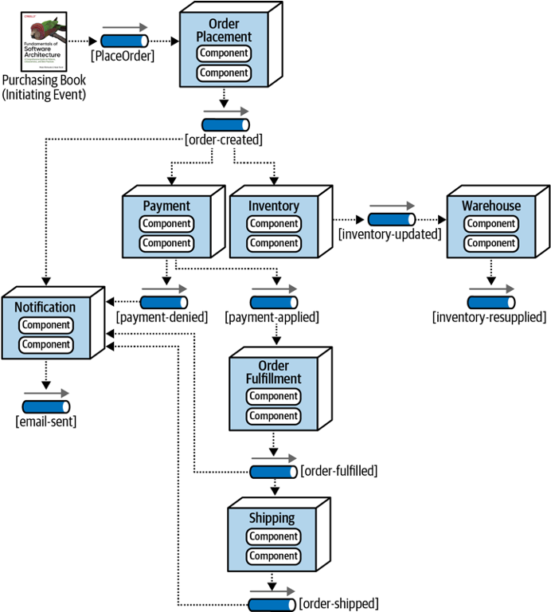
Event-Driven Architectures
Metaphor: a bunch of bureaucrats shuffling papers
Components correspond to stages in the flow of data through the system (not necessarily a straight-line flow)
Very useful for composing other services (bureaucrats)
Each processing unit has an in-box and one or more out-boxes
Each unit takes a task from its inbox, processes it, and puts the results in one or more outboxes.
Stages are typically connected by asynchronous message queues.
Notes:
(Read slide)

Slide 51
Microservices: Schematic Example
Different languages, different operating systems
NodeJS, MongoDB
Google Service
Java, MySQL
Todos
Logins
Mailer
Mod 1
Mod 2
Mod 3
REST service
REST service
REST service
Productivity App
Database
Database
Database
Frontend
REST
Search Engine
Analytics
Social Crawler
“Dumb”
App Server
Mod 4
Mod 5
Mod 6
REST service
REST service
REST service
Database
Database
Database
Java, Neo4J
C#, SQLServer
Python, MongoDB
Notes:
Here is an example of a micro services architecture for a productivity application. There are multiple components to this application. Each component is shown as a grey box, and is a micro service.
(Note the separation of responsibilities to entirely different services that only connect over a well-defined API)
Common question: How is this different from the event-based system? A: Picture looks very similar. Difference is that the services communicate directly with each other over a well-defined API, rather than having a message queue that routes the messages to the different services.

Slide 52

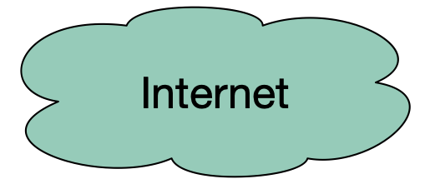
REST Principles
Single Server - As far as the client knows, there’s just one
Stateless - Each request contains enough information that a different server could process it (if there were multiple…)
Uniform Cacheability - Each request is identified as cacheable or not.
Uniform Interface - Standard way to specify interface
Clients
External Cache
Internal Cache
Web Servers
Client sees none of this!
Misc Services
App Servers
Database servers

Slide 53
100% Coverage may be Impossible
Path coverage (even without loops)
Dependent conditions: if (x) A; B; if (x) C;
Branch coverage
Dead Branches e.g., if (x < 0) A; else if (x == 0) B; else if (x > 0) C;
(x > 0) test will always succeed
Statement coverage
Dead code (e.g., defensive programming)
Notes:
<read slide>

Slide 54
How to evaluate the strength of test oracles?
Goal: “A good test suite finds all of the bugs”
Problem: How to know the bugs that we could make?
Strawman - “Seeded Faults”:
Create N variations of the codebase, each with a single manually-written defect
Evaluate the number of defects detected by test suite
Test suite is “good” if it finds all of the bugs you can think of
Notes:
(Read slide, then discuss)
Note that the strawman is probably something that we should do for particular faults that we really want to make sure we are testing for, and it is a good strategy to have in your back pocket. But, there are definitely problems with applying this at scale…
Do we write realistic bugs?
Do we inject all of the possible bugs?
Time intensive to inject bugs
This approach has been commonly used for grading student test suites.

Slide 55
Mutation Analysis tests the Tests
Idea: What if many (real) bugs could be represented by a single, one-line “mutation” to the program?
public contains(location: PlayerLocation): boolean {
return (
location.x + PLAYER_SPRITE_WIDTH / 2 > this._x &&
location.x - PLAYER_SPRITE_WIDTH / 2 < this._x + this._width &&
location.y + PLAYER_SPRITE_HEIGHT / 2 > this._y &&
location.y - PLAYER_SPRITE_HEIGHT / 2 < this._y + this._height
);
}
Correct code for ‘Contains” in IP1
public contains(location: PlayerLocation): boolean {
return (
location.x + PLAYER_SPRITE_WIDTH / 2 < this._x &&
location.x - PLAYER_SPRITE_WIDTH / 2 < this._x + this._width &&
location.y + PLAYER_SPRITE_HEIGHT / 2 > this._y &&
location.y - PLAYER_SPRITE_HEIGHT / 2 < this._y + this._height
);
}
Mutated (and buggy) code for ‘Contains” in IP1
Notes:
Mutation analysis is an automated approach to evaluate how good tests are at detecting bugs.
The key idea is to create “mutations” - variants of the code that are likely to be buggy. Then, we could determine whether our test suite detects these “mutants” as a proxy for detecting bugs that we might make.

Slide 56
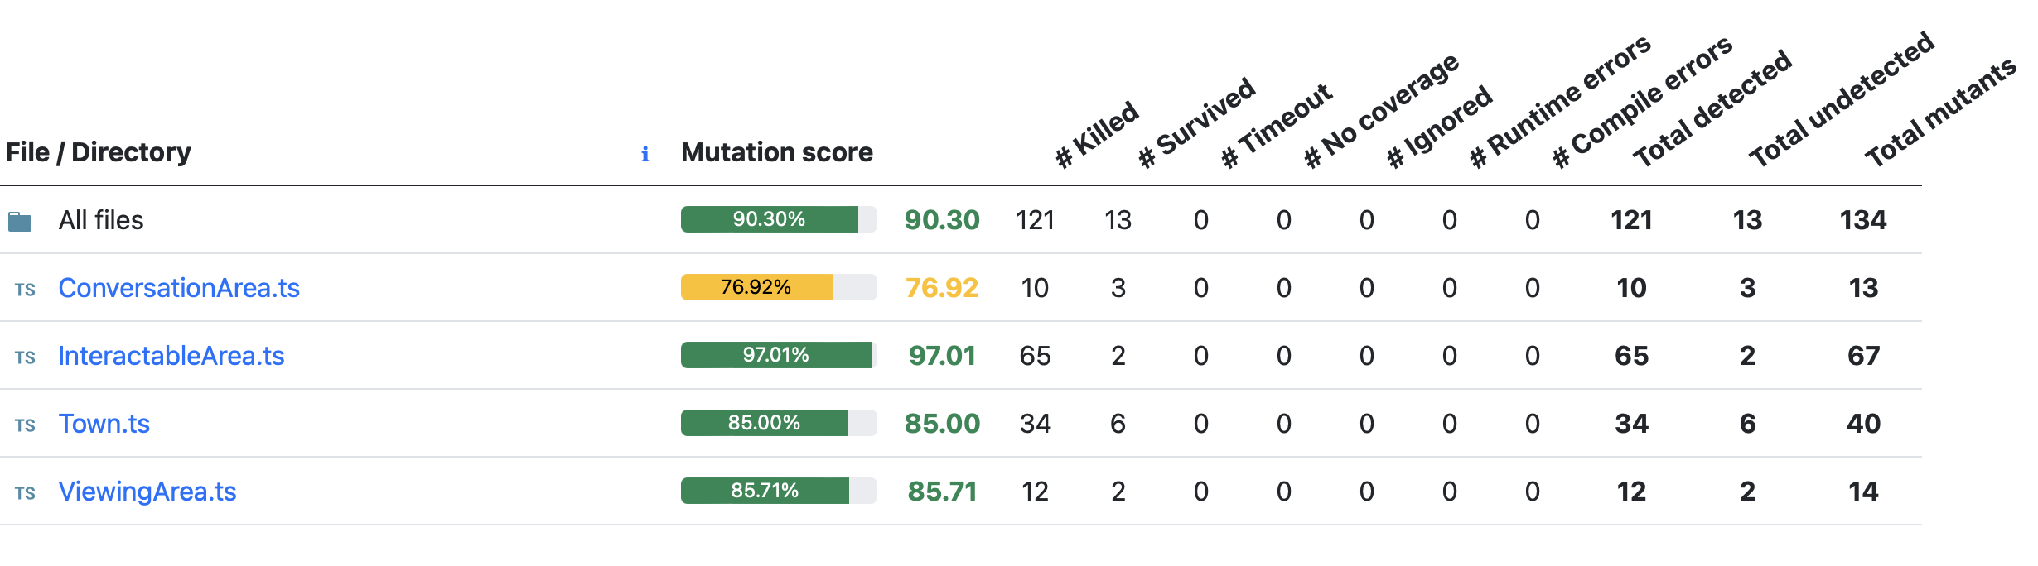
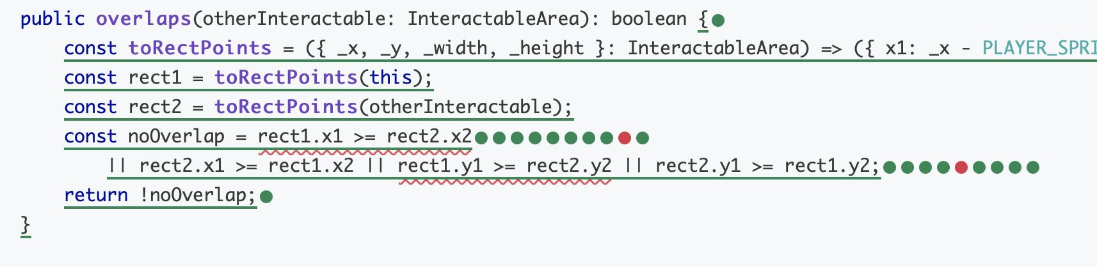
Mutation Report Shows Undetected Mutants
Mutants “detected” are bugs that are found
Mutants “undetected” might be bugs, or could be equivalent to original program (requires a human to tell)
Notes:
Review https://stryker-mutator.io/docs/ modifications in code are called mutants. After the mutants have been found, your tests are executed against them one by one. If at least one of your tests fail, we say the mutant is killed. That's what we want! If no test fails, it survived. The better your tests, the fewer mutants survive.

Slide 57
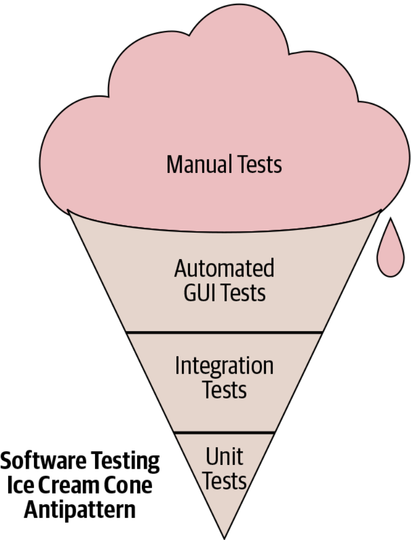
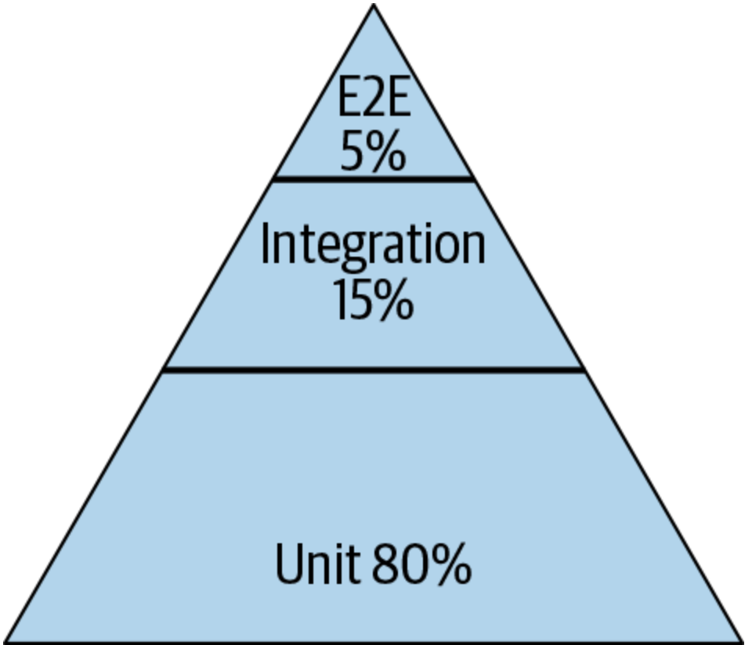
Testing Distribution (How much of each kind of testing we should do?)
Pyramid
Test Pattern
From SoftEng @ Google Chapter 11
https://learning.oreilly.com/library/view/software-engineering-at/9781492082781/ch11.html#testing_overview
Notes:
Typically we talk about this ice cream cone where we have a lot of a lot of manual tests, and then some automatic automated tests specifically related to GUI and then some integration tests and unit tests. The book that we mentioned earlier, software engineering at Google, recommends a different paradigm. It recommends that about 80% of your testing should be focused on unit testing and then about 15% on integration testing and then about 5% on end to end testing (what is known as system level testing).

Slide 58
What are Test Doubles?
Test Double
Test Double
Network
Resources
Business Logic
Mo
Test Double
Random user
Mock network
Database
Fake Database
Notes:
Doubles are things that look like the real thing but they are not real.
If you are working on a system which sends an email to customer after an operation, how will you test it? Instead of sending a real email every time you test, you can use doubles (i.e., a mock mail service)
One way to say this is: you need test doubles when you code (or function) has side effects.

Slide 59
Test Spy is a stub that remembers how the object was called
Test can check what happened earlier;
For example: a particular method should be called
First with parameters “foo” and 42;
Then with parameters “quux” and -88.
A spy can be useful in conjunction with the “real” environment:
What was sent on the network?
How many times a problem was logged?
What was inserted in the database?
Spy “remembers”
Notes:
Spies are stubs that also record some information based on how they were called. One form of this might be an email service that records how many messages it was sent. This is an example of spy being used with a real email service

Slide 60
Test Mock is a Double that has Scripted results
A test mock has scripted results:
If such-and-such a method is called
return some particular value.
A complex mock can have many scripts:
Multiple methods;
Different results for subsequent calls.
Useful mocking assumes we know how mocked object will be used.
Jest’s default behavior is to return “undefined”, we can modify this
Mock has “scripted answers” and is used for “behavior verification”
Notes:
Mocks are objects pre-programmed with expectations which form a specification of the calls they are expected to receive. It is used to record and verify the interaction between classes/components. A mock is known as the most powerful and flexible version of the test doubles.
The mock objects are generally used for behavior verification. The term behavior means to check the correct methods and paths that are applied to the objects.
Mocks are mostly created by using a library or a mocking framework like Mockito, JMock, and EasyMock. It is used for testing a large suite of tests where stubs are not sufficient.

Slide 61
Supply Implementation to Mocks to Simulate Behaviors
Sometimes called a fake, these mocks have an implementation of the object being replaced
A low-fidelity fake implements things partially
Enough to work for the test.
A high-fidelity fake implements most aspects:
Usually all functional aspects;
Usually not as efficiently or as scalable.
The purpose of this mock is to avoid processes/network/cost, but still perform some activities
Create fakes in Jest with mock.mockImplementation(…)
Fake has
“semi-real implementation”
Notes:
Fake objects actually have working implementations, but usually take some shortcut which makes them not suitable for production (an in memory database is a good example).
A fake is a simpler implementation of real objects.
Fakes are used when we want to test an infrastructural class, in other words, fakes are for the classes which are beyond our application limit (repositories or queues, for example).

Slide 62

Many Applications Rely on Common Infrastructure
Content delivery network: caches static content “at the edge” (e.g. cloudflare, Akamai)
Web servers: Speak HTTP, serve static content, load balance between app servers (e.g. haproxy, traefik)
App servers: Runs our application
Misc services: Logging, monitoring, firewall
Database servers: Persistent data
Content Delivery Network
Clients
Web Servers
App Servers
Misc Services
Database servers
Notes:
(Read slide)
Examples of why we need these things:
content delivery networks (CDNs) are helpful because they are very plentiful, but “dumb” caches. “Edge” means that they are located near customers, all around the world (the “edge” of the cloud). CDNs are really good for managing high volumes of load because the load is amortized across all of the CDN’s clients. A 100x influx in traffic for our app might be a lot, but on the scale of what CloudFlare or Akamai handle all day long, it’s a drop in the bucket. Hence, these systems are also effective for protection against “denial of service” (DoS) attacks. Before cloud flare existed to provide basically a free CDN to anyone who wants it, it was not very difficult to force a web app to stop working by overwhelming it with traffic.
Web servers are the “edge” of our app, and receive HTTP(s) traffic, forwarding it on to our application, and also possibly interacting with some misc services
App servers are running our actual application. For example, our transcript server API. We might want to have multiple app servers (for scalability), so the web server in front provides an opportunity for load balancing across them
Misc services could include things like logging, monitoring, and even an application firewall (e.g. some kind of anomaly detection system that identifies potentially malicious behavior and prevents it from reaching our app)
Database servers are where we store the persistent data…

Slide 63
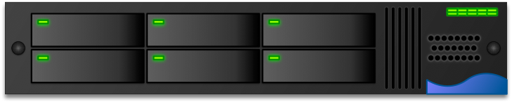
Infrastructure as a Service: Virtual Machines
Rely on virtualization to slice a single large server into many smaller machines
OS provides resource limits and quality guarantees per-VM
Each VM runs its own operating system
Examples: Amazon EC2, Google Compute Engine, Azure VMs
Application
Middleware
Operating System
Virtualization
Physical Server
VM4
VM5
VM6
Storage
VM3
Network
VM1
VM2
Physical data center
IaaS
A single server in the cloud
Self-managed
Vendor-managed
Notes:
One of the earliest forms of infrastructure-as-a-service provided by cloud vendors was virtualization. With virtualization, a single physical server can be split into multiple “virtual servers”, which enforce resource limits and quality guarantees per-VM. Each VM runs its own operating system, and the software running in the VM is agnostic to the fact that there is a VM instead of a physical server that runs it.
Although the idea of Virtualization started with IBM’s mainframe, it really became popular when Vmware introduced its x86 server called ESC Server in 2000s.

Slide 64
Virtual Machines to Containers
Each VM contains a full operating system
What if each application could run in the same (overall) operating system? Why have multiple copies?
Advantages to smaller apps:
Faster to copy (and hence provision)
Consume less storage at rest
Application
Application
Middleware
Middleware
Operating System
Operating System
Virtualization
Virtualization
Physical Server
Physical Server
Storage
Storage
Network
Network
Physical data center
Physical data center
VMs as a service
Containers as a service
Self-managed
Vendor-managed
Notes:
(Read slide)
This problem surfaced within Google in the mid 2000’s, resulting in the development of Linux control groups (cgroups), containers, and docker

Slide 65
PaaS is the Simplest Choice for App Deployment
Platform-as-a-Service (PaaS) products provide common components that most apps need, fully managed by the vendor: load balancer, monitoring, application server
Examples: Heroku, AWS Elastic Beanstalk, Google App Engine
Some PaaS products are designed to deploy apps as single functions that are invoked when a web request is made, and don’t run otherwise (“function-as-a-service”)
Examples: AWS Lambda, Google Cloud Functions, Azure Functions
Some PaaS products also provide databases and authentication
Examples: Google Firebase, Back4App
Application
Middleware
Operating System
Virtualization
Physical Server
Storage
Network
Physical data center
PaaS

Slide 66
Self-managed vs Vendor-managed Infrastructure
Application
Application
Application
Benefits to vendor-managed options:
Greater opportunity to reduce resource consumption, improve resource utilization
Less management burden
Less capital investment, greater operating expenses
Benefits to self-managed options:
Greater flexibility and avoid vendor lock-in
More capital investment, less operating expenses
Middleware
Middleware
Middleware
Operating System
Operating System
Operating System
Virtualization
Virtualization
Virtualization
Physical Server
Physical Server
Physical Server
Storage
Storage
Storage
Network
Network
Network
Physical data center
Physical data center
Physical data center
Traditional, on-premises computing
IaaS
SaaS
Self-managed
Vendor-managed
Notes:
As we have seen, there is a wide spectrum between traditional, on-premises computing, infrastructure as a service, platform as a service, and software as a service options.

Slide 67
Continuous Integration is a Software Pipeline
Develop
Build
Test
Deploy
Monitor
End-to-end Test
KPIs
Code Review
Style Check
Integration Test
0…………….
Compile
Load Test
Unit Test
Prepare Deployment
Automate this centrally, provide a central record of results
Notes:
So, the core to continuous integration is to centrally and automatically execute these development processes, regularly.
With CI, we continuously assemble and test changes to our codebase. By performing these integrations quickly and frequently, we can get faster feedback, and hence, “shift left” - allowing bugs to be detected sooner. There’s an enormous difference in how long it takes to debug something if you detect the bug immediately after writing the code versus even, say, the next day - let alone after several weeks.
CI processes are software pipelines. Recall from our discussion of software architectures that “pipeline” systems are good for building systems that have a specific order of operations, with dependencies between some steps. CI workflows follow this pattern: some steps depend on others (can’t test until you build), but many steps might be possible in parallel (run many different kinds of tests concurrently)

Slide 68

Continuous Integration in Practice
Small scale, with a service like CircleCI, GitHub Actions or TravisCI
GitHub
Commits code to
Checks for updates
Developer
GitHub Actions
TravisCI
CircleCI
Runs build for each commit
Notes:
Run an entire test suite on each commit, or perhaps do other things. Each commit triggers some workflow to run, and we can customize that workflow to do anything from building our code, to running tests, to deploying infrastructure.

Slide 69
Code Review should be a Formal Process
A code review is the process in which the author of some code is asked to explain it to their peers:
What purpose the code has;
How the code accomplishes this purpose;
How the author is confident of this information,
E.g., show results of running tests (CI results)
A code review often concerns a code change (“diff”)

Slide 70
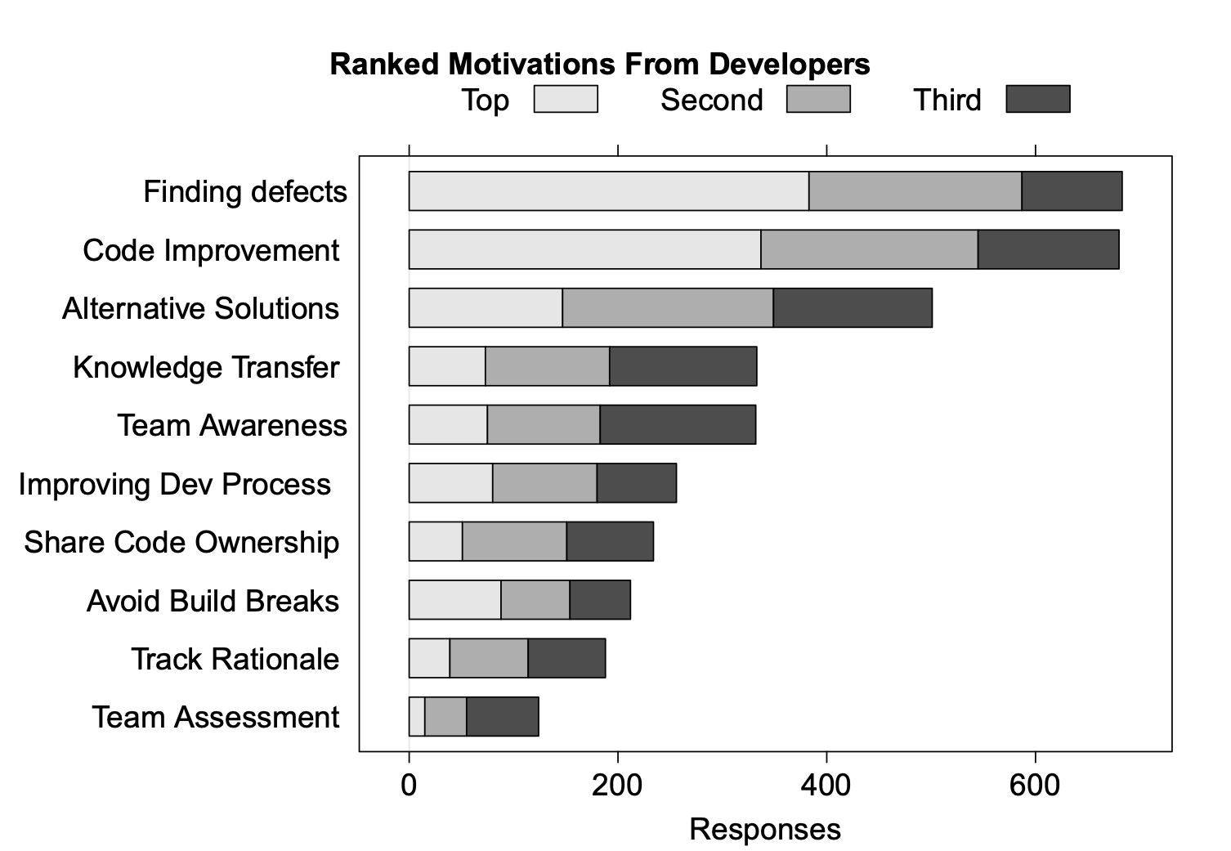
Code Reviews Have Many Benefits (Microsoft)
“Expectations, Outcomes, and Challenges of Modern Code Review”, Bacchelli & Bird, ICSE 2013
Notes:
Check code quality attributes that are hard to automatically check: security, compliance, scalability

Slide 71
Continuous Delivery
“Faster is safer”: Key values of continuous delivery
Release frequently, in small batches
Maintain key performance indicators to evaluate the impact of updates
Phase roll-outs
Evaluate business impact of new features
Notes:
Thanks to the automated software integration pipeline that we’ve built, we can now work on closing the last feedback loop: by delivering our updates frequently, we can observe the impact of each update in relative isolation. We can be agile - releasing frequently, in small batches of updates. Thanks to automation from our CI + infrastructure system, we should be able to release with relatively low human overhead. We can maintain performance indicators like crashes, or latency and work on improving them. We can roll-out these changes to just a few users before shipping to everyone, and use this data to help determine if we should do that roll-out or not. We can even use this approach to evaluate whether newly designed features are used by users as our product designers intended - for instance, if we are implementing improvements to the usability of a commenting system, we might measure whether there are more comments made using the new feature or not. There are a few tricks that we can use to make this all work (and not make our software worse).

Slide 72
Staging Environments
Enabling Continuous Delivery
As software gets more complex with more dependencies, it's impossible to simulate the whole thing when testing
Idea: Deploy to a complete production-like environment, but don't have everyone use it
Examples:
“Eat your own dogfood”
Beta/Alpha testers
Lower risk if a problem occurs in staging than in production
Notes:
A key pre-requisite for continuous delivery is a staging environment .(read slide)
Example: apple gives their employees iphone for testing. Slack/facebook employees are “forced” to be part of beta testing. We use internal developers to serve as testers.

Slide 73
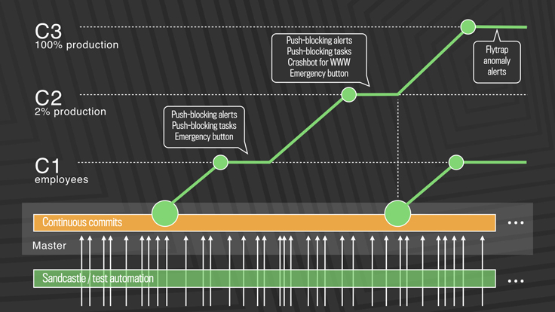
Deployment Example: Facebook.com
Post-2016: Truly continuous releases from master branch
https://engineering.fb.com/2017/08/31/web/rapid-release-at-massive-scale/
Notes:
This approach solves the problem of scaling continuous delivery. In Facebook’s new deployment model, there is no manual cherry-picking, and there are automated processes to detect anomalies and revert changes. There are three-tiers of deployment, from C1 (dog-fooding/staging) to C2 (deployment to a small slice of production) to C3 (deployment to entirety of production workload)
The process works like this: (copied from blog post)
First, diffs that have passed a series of automated internal tests and land in master are pushed out to Facebook employees. In this stage, we get push-blocking alerts if we’ve introduced a regression, and an emergency stop button lets us keep the release from going any further. If everything is OK, we push the changes to 2 percent of production, where again we collect signal and monitor alerts, especially for edge cases that our testing or employee dogfooding may not have picked up. Finally, we roll out to 100 percent of production, where our Flytrap tool aggregates user reports and alerts us to any anomalies.
Many of the changes are initially kept behind our feature flags, which allows to roll out mobile and web code releases independently from new features, helping to lower the risk of any particular update causing a problem. If we do find a problem, we can simply switch the feature off rather than revert back to a previous version or fix forward.

Slide 74
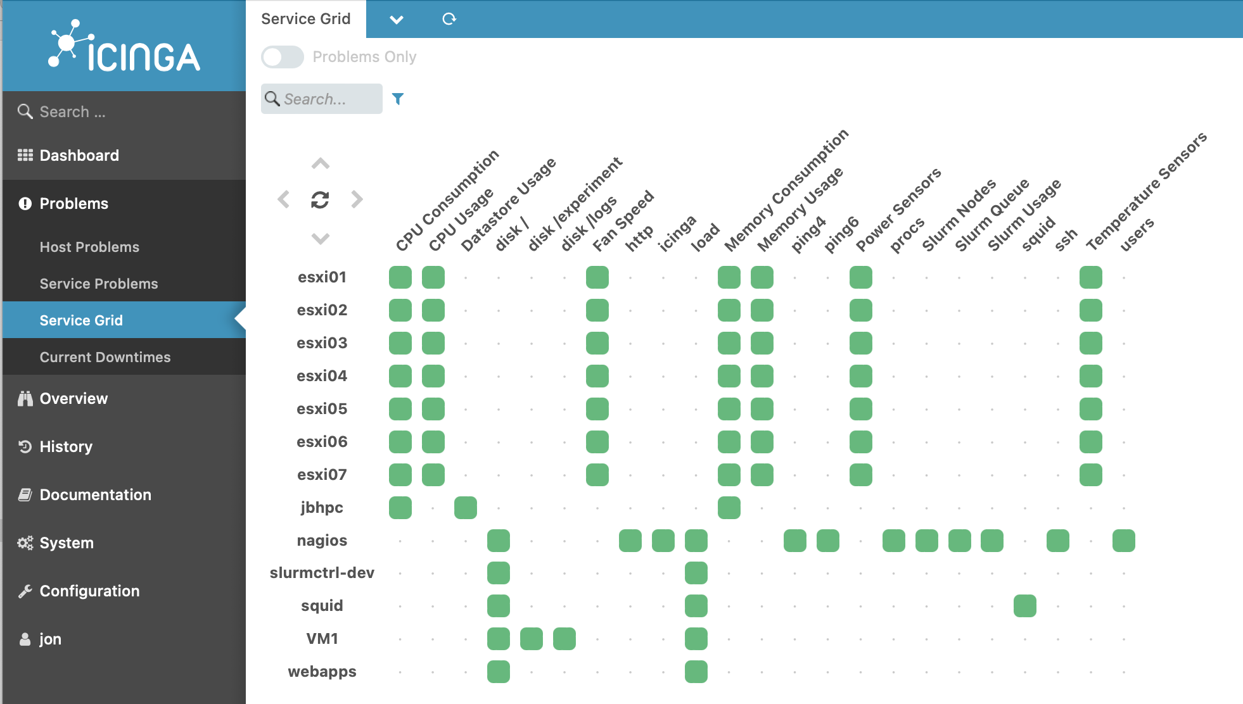
Monitoring Services Aggregate System Status
Notes:
Once we decide the metrics to track, we can aggregate them into one place to see the overall system status. For example, here is a screenshot of the open-source monitoring platform called Iciniga (good luck pronouncing it, try Aye-Singa)’s “Service grid” overview, which shows all of the services that are being tracked, all of the KPIs that are being tracked, and the overall status of each KPI on each service

Slide 75
Summary
Don’t forget to review
Slides for all modules (from course website)
IP1 and IP2
Activities

